Slide 1
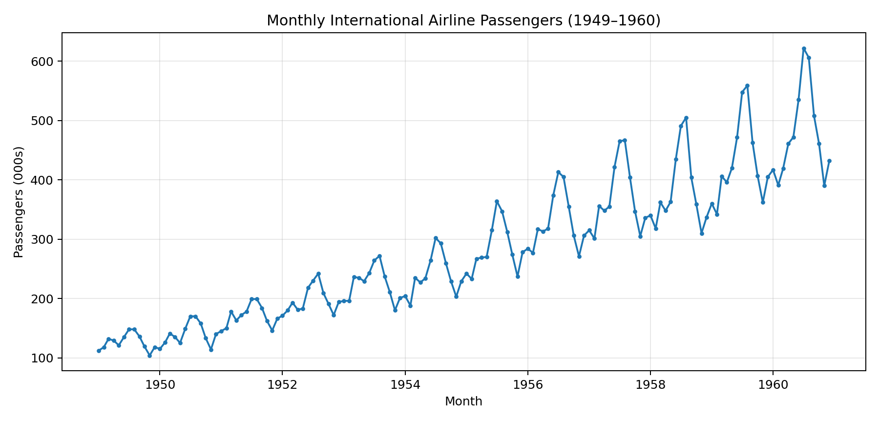
Airline Passengers Prediction Pipeline
Linear Regression • XGBoost • ANN • LSTM • ARIMA
Dataset: monthly international airline passengers, 1949–1960. Goal: build and compare forecasting models for the final 24 months.
20.53
24 months
5
Best RMSE
Test horizon
Models
01

Slide 2
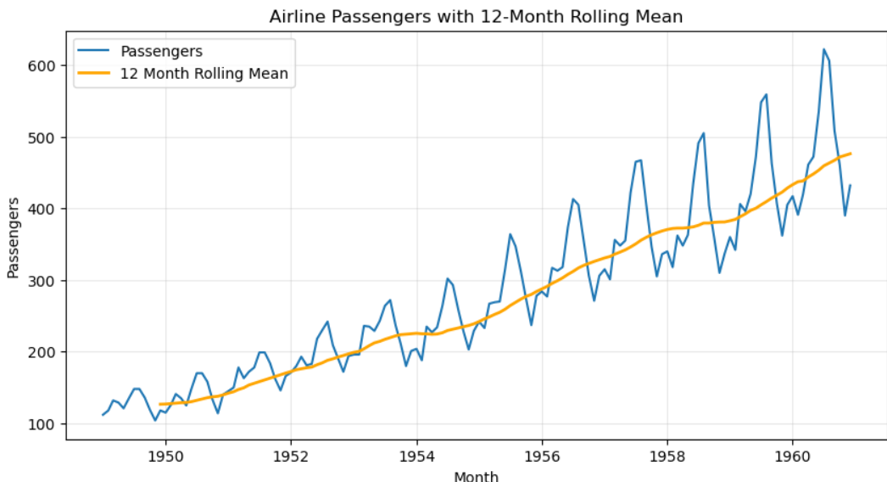
1. Data Understanding and Project Objective
Target variable: Passengers, measured monthly in thousands.
Time range: January 1949 to December 1960, 144 observations.
Forecasting task: predict the final 24 months using historical pattern information.
Main challenge: trend + seasonality + limited dataset size.
144
0
1959–1960
Rows
Missing values
Forecast holdout
02

Slide 3
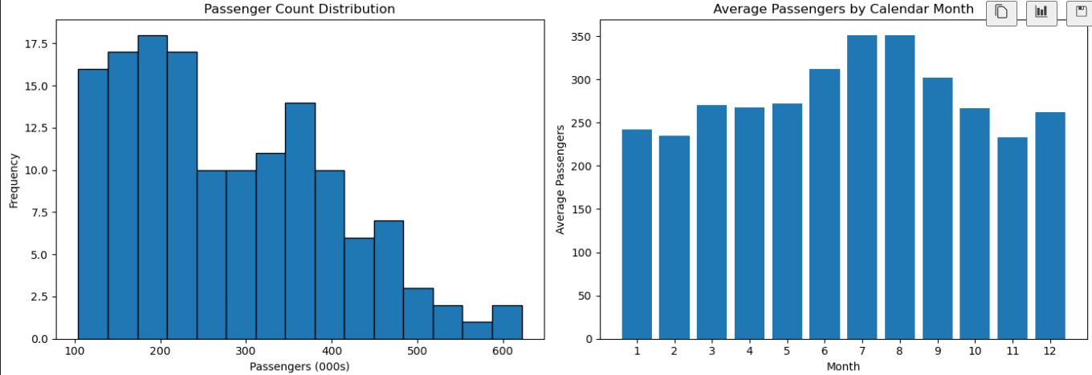
4. Exploratory Data Analysis
Distribution
Seasonal monthly average
05

Slide 4
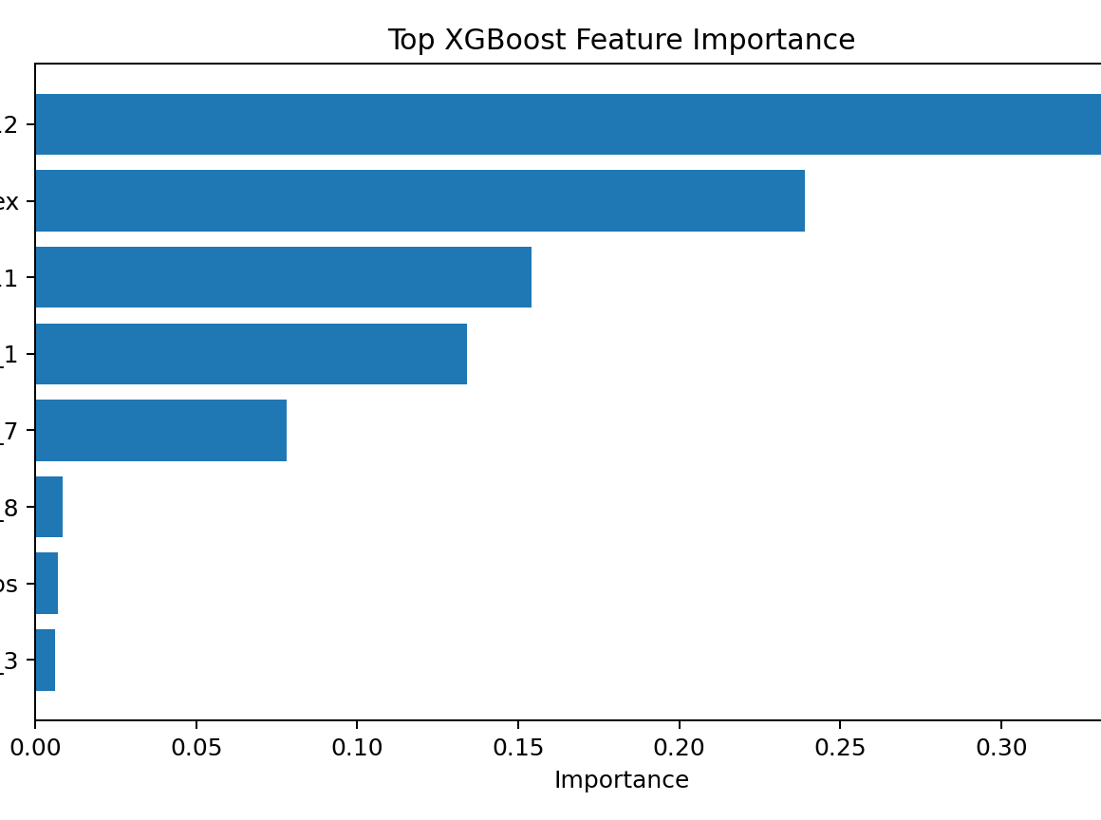
5. Feature Engineering and Data Preparation
Lag features capture short-term persistence and previous seasonal values.
Month_sin and Month_cos encode cyclic calendar seasonality.
TimeIndex allows models to learn the long-term upward trend.
Scaling prevents neural network training from being dominated by larger numeric values.
XGBoost importance suggests recent lags and annual seasonal lags are the strongest engineered predictors.
06

Slide 5
6. Model Development
Five models were built to compare simple baselines, tree models, neural networks, and statistical time-series methods.
Linear Regression
Uses lag/calendar features; strong interpretable baseline.
XGBoost
Nonlinear boosting model; handles feature interactions.
ANN
Feed-forward neural network trained on scaled supervised features.
LSTM
Sequence model using the previous 12 months as input.
ARIMA
Seasonal statistical forecasting model trained on time series.
07

Slide 6
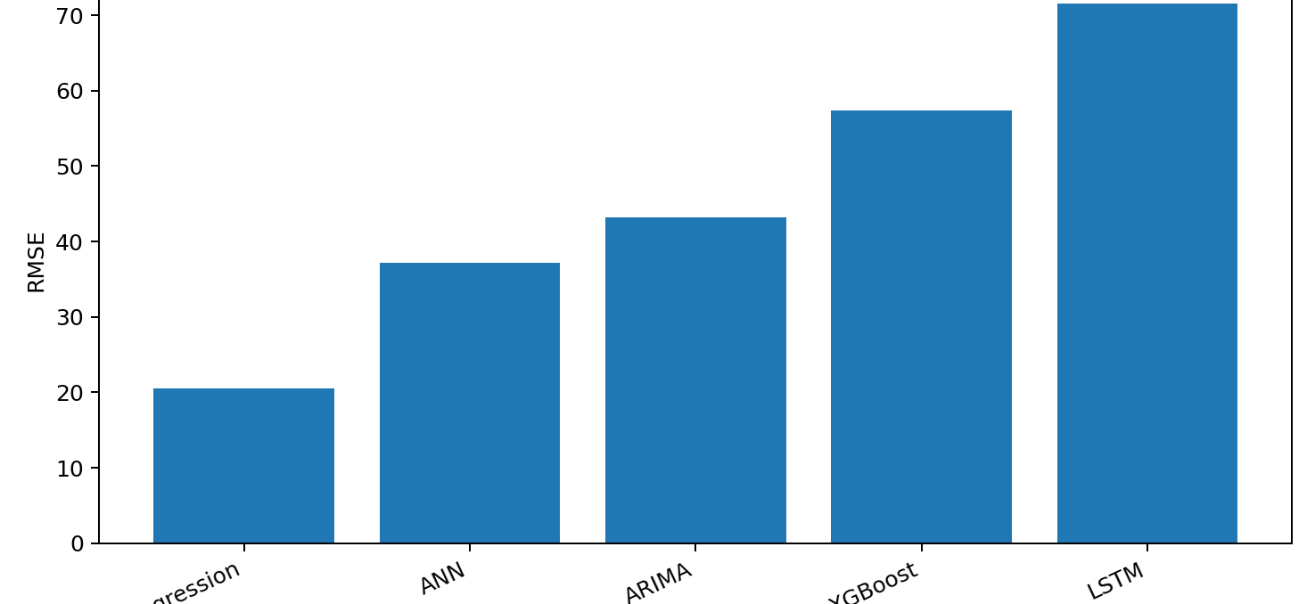
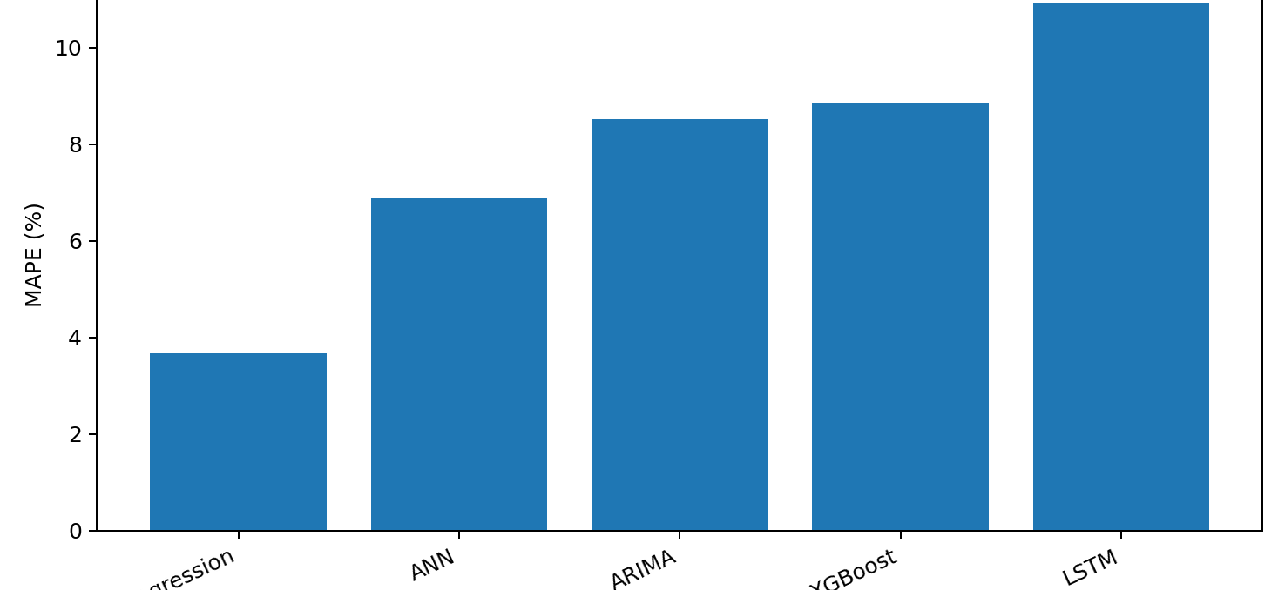
8. Comparative Results
Linear Regression produced the lowest error on the 24-month holdout period.
Rank Model RMSE MAE R² MAPE 1 Linear Regression 20.53 16.39 0.924 3.67% 2 ANN 37.13 31.94 0.753 6.88% 3 ARIMA 43.19 39.45 0.666 8.52% 4 XGBoost 57.39 43.41 0.409 8.87% 5 LSTM 71.49 53.76 0.083 10.91%
Best model: Linear Regression — simple lag + calendar features captured this dataset better than more complex models.
09

Slide 7
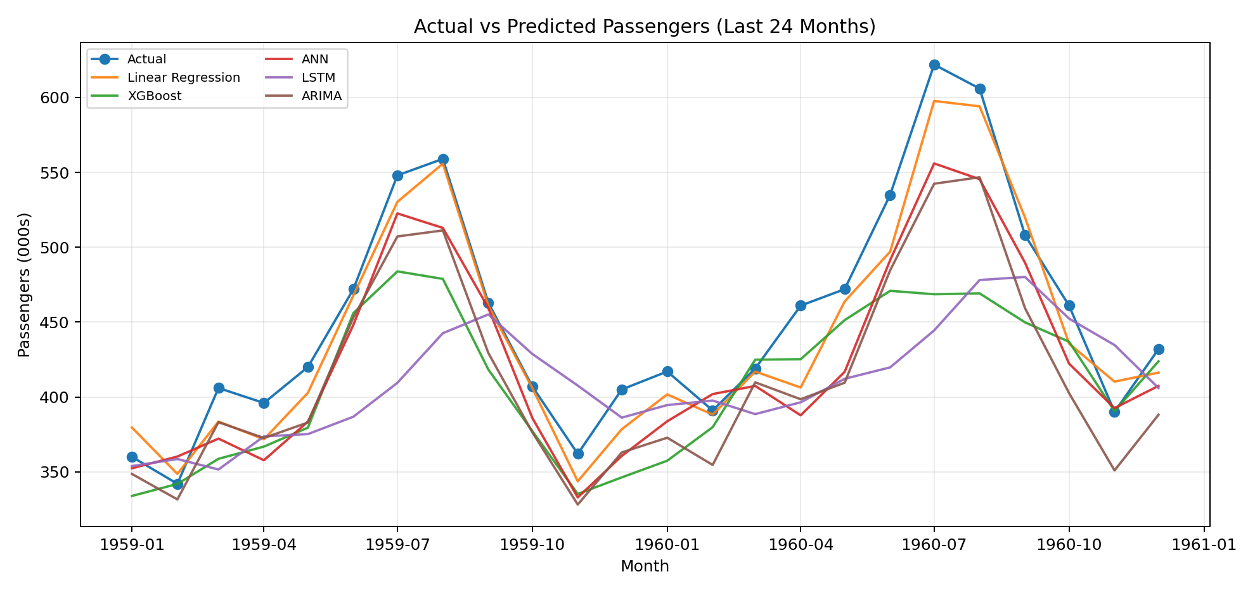
9. Actual vs Predicted Forecasts
Visual takeaway: Linear Regression tracks the broad seasonal shape most closely; XGBoost and LSTM are more conservative near large seasonal peaks.
10

Slide 8
10. Strengths, Limitations and Performance Differences
Model complexity did not automatically improve performance because the dataset is small and highly structured.
Model group Strength Limitation
Linear Regression
Strong baseline, interpretable, captures lag patterns
May miss nonlinear shocks
XGBoost
Learns nonlinear interactions
Can under-extrapolate outside training range
ANN/LSTM
Can learn complex patterns with enough data
Needs more data; sensitive to scaling and tuning
ARIMA
Designed for time series and seasonality
Requires stationarity assumptions and parameter selection
Main reason for the ranking: the data has a clear yearly pattern, and lag-based linear features fit that structure efficiently without overfitting.
11

Slide 9
11. Key Insights and Recommendations
Use Linear Regression as the baseline production model for this small dataset.
Keep ARIMA as a statistical benchmark for seasonal forecasting tasks.
Avoid relying only on LSTM/ANN unless more historical observations or external variables are available.
Add external features such as holidays, fuel prices, economic indicators, or flight capacity to improve forecasts.
Use rolling-origin cross-validation for stronger future work instead of one fixed train/test split.
Final recommendation: start simple, validate carefully, then scale model complexity only when the data supports it.
12

